Slide 1

Oracle - Day 5
Education and Research
We enable you to leverage knowledge anytime, anywhere!
Long Cycle
ER/CORP/CRS/LA1010/003
Ver. No.: 4.0
Confidential
Copyright © 2008, Infosys Technologies Ltd.

Slide 2
General Guideline
© (2008) Infosys Technologies Ltd.
This document contains valuable confidential and proprietary information of Infosys. Such confidential and proprietary information includes, amongst others, proprietary intellectual property which can be legally protected and commercialized. Such information is furnished herein for training purposes only. Except with the express prior written permission of Infosys, this document and the information contained herein may not be published, disclosed, or used for any other purpose.

Slide 3
Confidential Information
This Document is confidential to Infosys Technologies Limited. This document contains information and data that Infosys considers confidential and proprietary (“Confidential Information”).
Confidential Information includes, but is not limited to, the following:
  Corporate and Infrastructure information about Infosys
  Infosys’ project management and quality processes
  Project experiences provided included as illustrative case studies
Any disclosure of Confidential Information to, or use of it by a third party, will be damaging to Infosys.
Ownership of all Infosys Confidential Information, no matter in what media it resides, remains with Infosys.
Confidential information in this document shall not be disclosed, duplicated or used – in whole or in part – for any purpose other than reading without specific written permission of an authorized representative of Infosys.
This document also contains third party confidential and proprietary information. Such third party information has been included by Infosys after receiving due written permissions and authorizations from the party/ies. Such third party confidential and proprietary information shall not be disclosed, duplicated or used – in whole or in part – for any purpose other than reading without specific written permission of an authorized representative of Infosys.

Slide 4
Session Plan Day5
Introduction to Pro*C/C++
  What is Precompiler?
  Embedded SQL
  Oracle Precompliers
  Advantage of Pre-Complier
  Static Statement
  Dynamic Statement
Embedded SQL Programming
  Embedded SQL Statements
    Executable Statements
    Declarative Statements
  Variables
    Host variables
    Indicator Variables
    Varchar variables

Slide 5
Recap
Creating and Managing Packages
Database Triggers
Understanding Dependencies among PL/SQL Constructs

Slide 6
Programming Using Pro *C/C++
Education and Research
We enable you to leverage knowledge anytime, anywhere!
ER/CORP/CRS/LA1010/003
Ver. No.: 4.0
Confidential
Copyright © 2008, Infosys Technologies Ltd.

Slide 7
Introduction to Pro*C/C++
Pre-compilers
  Pre-compilers are tools that allow you to embed SQL statements in the HLL (High Level Language) source code.
  Pre-compilers accept SQL statements , translate the SQL statements into runtime calls , generate a source code that can be compiled, linked and executed.
Notes:
The Pro*C precompiler enables developer to create an applications that can access
Oracle database whenever rapid development and compatibility with other systems are developer’s priorities.
The Pro*C programming tool enables you to embed Structured Query Language
(SQL) statements in a C program.
The Pro*C precompiler translates these statements into standard Oracle runtime library
calls, then generates a modified source program that you can compile, link, and run in
the usual way.

Slide 8
Oracle Pre-compilers
Oracle supports pre-compilers for the following HLL
    C
    COBOL
    Fortran
    Pascal
    PL/I
    Ada
Oracle supports all this on different platforms like UNIX,DOS, NETWARE,WINDOWS,VAX,SUN... etc
Notes:
Oracle supports pre-compilers for the following HLL,
C
COBOL
Fortran
Pascal
PL/I
Ada
Oracle supports all this on different platforms like UNIX,DOS, NETWARE,WINDOWS,VAX,SUN... etc

Slide 9
Advantages of Pre-compilers
Write applications using High level programming language
Embed SQL in HLL programs.
Automatically convert datatypes
  between those supported by Oracle and the Programming Language.
Translate SQL queries into appropriate programming language code automatically
Handle errors and warnings
  using the SQLCA (SQL Communication Area)
  and WHENEVER – Explained further
Separate pre-compilation of the program modules and then linking them together.
Notes:
Write applications using High level programming language
Embed SQL in HLL programs.
Automatically convert datatypes
between those supported by Oracle and the Programming Language.
Translate SQL queries into appropriate programming language code automatically
Handle errors and warnings
using the SQLCA (SQL Communication Area)
and WHENEVER – Explained further
Separate pre-compilation of the program modules and then linking them together.

Slide 10
Static SQL Statement
In some case, you know the makeup of each SQL statement and transaction before runtime; that means, you know which SQL commands will be issued, which database tables might be changed, which columns will be updated etc.
Such statements are known as static Statements.
Most application programs are designed to process static SQL statements and fixed transactions.
Notes:
Static SQL Statements
In Some case, you know the makeup of each SQL statement and transaction before runtime; that means, you know which SQL commands will be issued, which database tables might be changed, which columns will be updated during compile time.
Such statements are known as static Statements.
Most application programs are designed to process static SQL statements and fixed transactions.

Slide 11
Dynamic SQL Statement
Some applications might be required to accept and process any valid SQL statement at runtime. So, you might not know until runtime all the SQL commands, database tables, and columns involved.
Such statements are known as Dynamic Statements
Dynamic SQL is an advanced programming technique that lets your program accept or build SQL statements at run time and take explicit control over datatype conversion.
Notes:
But there are some applications which might be required to accept and process any valid SQL statement at runtime. So, you might not know until runtime all the SQL commands, database tables, and columns involved.
Such statements are known as Dynamic Statements
Dynamic SQL is an advanced programming technique that lets your program accept or build SQL statements at run time and take explicit control over data type conversion.

Slide 12
Embedded SQL- Definition
SQL statements within a programming language called Embedded SQL statements.
The source code containing the embedded SQL is called Host program.
Embedded SQL statements in the source code begin with EXEC SQL
Example:
EXEC SQL INSERT INTO branch (bcode,location)
VALUES (:br_code.:br_location);
Notes:
SQL statements within an application program are called Embedded SQL statements. The application program containing the embedded SQL is called Host program.
Almost all SQL statements can be used within your application program:
CREATE, DROP, ALTER, INSERT, UPDATE, DELETE, RENAME, SELECT, GRANT, REVOKE, COMMIT and ROLLBACK.
:br_code and :br_location are host variables which will be explained in forthcoming slides.

Slide 13
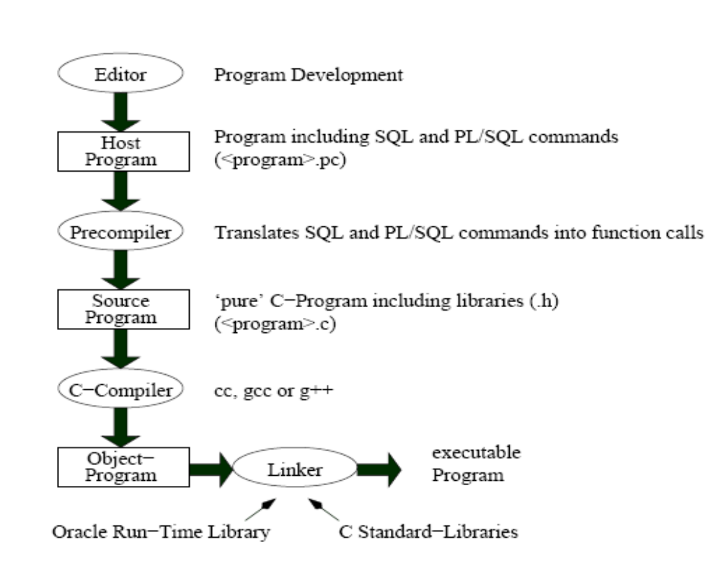
Embedded SQL Program Dev – The big picture Translation of a Pro*C Program
Notes:
Let us now discuss the various steps involved in development process of Embedded SQL Program
In the Embedded SQL Program Development
At very first step we create a source program using any editor and save it as .pc file.,the source file will have source program embedded with SQL statements
In the next step oracle precompiler (like pro*c) translates the embedded SQL statements into standard Oracle runtime library calls and replaces SQL statements by Library calls
and generates a modified source program
This source program is a purely c program which is given to any c complier to compile and return an object code which can be link and execute.
While execution ORACLE Run time Library(SQLLIB) will be invoked to execute SQL statements.

Slide 14
Types of Embedded SQL Statements
The Embedded SQL Statements can be categorized in two parts:-
  Executable Statements
  Declarative Statements
Notes:
The Embedded SQL Statements can be categorized in two parts:-
1) Executable Statements
2) Declarative Statements

Slide 15
Executable statements
  Executable statements result in calls to the runtime library SQLLIB.
  You use them to connect to Oracle, to define, query, and manipulate Oracle data, to control access to Oracle data, and to process transactions.
  They can be placed wherever C or C++ language executable statements can be placed.

Slide 16
Executable Statements
Result in calls and return codes to Oracle.
They are used to connect to the ORACLE database, define, query, manipulate and control access to the Oracle Database.
Example:
  EXEC SQL insert into branch values(:brcode,:br_location,:br_mgr);
Notes:
Executable statements result in calls and return codes to Oracle. The executable statements are used to connect to Oracle DBMS, to define, query, manipulate and control access to the Oracle database and to process transactions.
ALTER, CREATE, DROP, RENAME, CONNECT, GRANT, REVOKE, LOCK TABLE statements allow you to define and control access to Oracle data.
DELETE, INSERT, UPDATE, manipulation of Oracle data.
CLOSE, FETCH, OPEN, SELECT retrieve Oracle data.
COMMIT, ROLLBACK to process transactions.
DESCRIBE, EXECUTE, PREPARE for performing Dynamic SQL.
Example:
EXEC SQL INSERT INTO branch (bcode,location)
VALUES (:br_code.:br_location);

Slide 17
Declarative Statements
All statements that allow you to declare variables(host variables) used in SQL statements , Communication areas and Oracle objects.
Following keywords are used for the respective job:
    DECLARE for Oracle objects
    INCLUDE for communication areas
    WHENEVER for error handling
Notes:
These statements allow you to declare Oracle objects, communication areas and SQL variables.
For example:
EXEC SQL BEGIN DECLARE SECTION;
EXEC SQL END DECALRE SECTION;
Let us explore the three keywords one by one.

Slide 18
Example: Using DECLARE
EXEC SQL BEGIN DECLARE SECTION;
  int emp_no;
  char emp_name[30];
  float emp_sales;
  short ind_sales;
EXEC SQL END DECLARE SECTION;
Notes:
Please note that this is a code snippet. Don’t try this alone.

Slide 19
Example: Using INCLUDE
EXEC SQL INCLUDE sqlca;
SQLCA is the SQL communication area between Oracle and your Pro *C/C++ program
SQLCA is a structure

Slide 20
Types of Variables
      Host variables
      Indicator Variables
Notes:
Pro* c provides two types of variables:-
1) Host variables
2) Indicator Variables

Slide 21
Host variables
Host variables allow communication between Oracle and your program.
Host variables must be declared using the host language data types and rules.
  Must be prefixed with a colon in SQL statements
  Data types must be supported by host language.
A host variable must not be
  Used as an array subscript
  be prefixed with colon in host language statements.

Slide 22
Host variables
Host variables are of two types
  Input
    Program assigns values to input host variables and passes data to ORACLE
  Output
    ORACLE assigns values to output host variables and passes data to program
Notes:
Host variables can be of input or output type. Input host variable passes data to Oracle whereas Output host variables pass Oracle data and status information to your program.
Example:
EXEC SQL SELECT NAME, TITLE, BRANCH INTO : empname,: emptitle,:empbranch
FROM salesrep WHERE empno = :mempno;

Slide 23
Indicator Variables
Every host variable can be associated with an indicator variable.
Used for
  assigning null values to input host variables.
  Detect null or truncated values in output host variables.
They must be
  declared in the declare section.
  Prefixed with a colon(:) in the SQL statement.
They cannot be
  used in the WHERE clause of an SQL statement
Notes:
data type of indicator variables are always of short type.
For Eg:-
/* Host Variables*/
struct
{
char empname[80];
int salary;
int commission;
} emprec;
/*Indicator Variables*/
struct
{
short empname_ind;
short salary_ind;
short commission_ind;
} emprec_ind;

Slide 24
Example: Using Host variables
main(){
printf(“Enter the employee number”);
scanf(“%d”,&emp_no);
/* usage of host and indicator variables*/
EXEC SQL select name,ytdsales into :emp_name , :emp_sales:ind_sales from salesrep where empno = :empno;
if (ind_sales == -1)
printf(“No sales achieved by %s”,emp_name);
else
printf(“sales achieved ny %s is %d”,emp_name,emp_sales);
}
Notes:
Please note that this is a code snippet. Don’t try this alone.
Example 1:- Input host variable
EXEC SQL insert into branch values(:brcode,:br_location,:br_mgr);
Example 2:- Output host variable
EXEC SQL select Name,Salary,Comm into :empName,
:salary,:commission
from employee where EmpNo =:empNo;

Slide 25
Varchar variables
VARCHAR variable is used to declare variable-length character strings.
VARCHAR is a pre-declared structure.
Example:-
EXEC SQL BEGIN DECLARE SECTION;
  varchar username[20];
EXEC SQL END DECLARE SECTION;
translates to:-
  struct{
    unsigned short len;
    unsigned char arr[20];
    } username;
Notes:
Now let us discuss about varchar variable which can be declared as a host variable
VARCHAR variable is used to declare variable-length character strings.
It is a pre-declared structure.
Here is one example to declare varchar variable username.
Precompiler translates the varchar variable internally to, predefined structure having data type unsigned short and unsigned char.

Slide 26
Varchar variables
If the VARCHAR is an input host variable:-
      You must tell Oracle what length to expect.
      Set the length component to the actual length of the
      value stored in the string component.
      Before passing an input VARCHAR variable to ORACLE, always assign the length member to a valid length.
Example:
varchar userName[20];
…
strcpy(userName.arr,"veena");
userName.len = strlen(userName.arr);
SQL> INSERT INTO usertable VALUES(:userName);
Notes:
VARCHAR variable when used with input host variable:-
You have to Explicitly Specify the length of the variable
And Set the length component to the actual length of the value stored in the string component.
For Example:
We have declared one varchar host variable username having a length of 20.
before using it in the insert statement we have assigned the length member to a valid length

Slide 27
Varchar variables
If the VARCHAR is an output host variable:-
      Oracle automatically sets the length component.
      After obtaining a value into an Output host variable of type VARCHAR, always terminate the variable value with string terminator(‘\0’)
Example:
exec sql
select Name,Salary,Comm into
:empName:empName_ind, :salary:salary_ind,:
commission:comm_ind
from employee where EmpNo =:empNo;
empName.arr[empName.len]='\0';
Notes:
If the VARCHAR is an output host variable:-
Oracle automatically sets the length component.
After obtaining a value into an Output host variable of type VARCHAR, always terminate the variable value with string terminator(‘\0’)
For Example in the given slide after obtaining a value the varchar data type member is terminating with null character called as string termintor(‘\0’)

Slide 28
Example
#include <stdio.h>
#include <string.h>
#include <sqlca.h>
void main() {
EXEC SQL BEGIN DECLARE SECTION;
char user_id[]=“scott/tiger@enrdb";
int emp_no;
struct {
char empname[80];
int salary;
int commission;
} emprec;
struct{
short empname_ind;
short salary_ind;
short commission_ind;
} emprec_ind;
EXEC SQL END DECLARE SECTION;
Notes:
Here is one complete prog on Proc.
The objective of the prog is to fetch employee details for a given empno.
First we have the header file declaration section.
Other than the header file which are required for c prog we have to decalre sqlca header file which is mandatory in the prog.
we’ ll have a detail discussion about Sqlca in the later slide.
In EXEC SQL BEGIN DECLARE SECTION and EXEC SQL END DECLARE SECTION block
we declare required host and indicator variable ,The datatype of indicator variable will always be a short type.
Variable User id is declared to store the user authentication, which is used for oracle connectivity in the prog.
variable likes emp name, salary, commission which is defined under a structure to store employee related detail respectively.

Slide 29
Example(Contd….)
EXEC SQL CONNECT :user_id;
for(;;)
{
printf("\nEnter Empno [0 to quit]");
scanf("%d",&emp_no);
if(emp_no==0)
break;
EXEC SQL SELECT ENAME,SAL,COMM INTO :emprec:emprec_ind FROM EMP WHERE EMPNO=:emp_no;
printf("\n Empno %d",emp_no);
printf("\n Sal %d",emprec.salary);
if (emprec_ind.commission_ind==-1)
printf("\n no commission");
else
printf("\n commission %d",emprec.commission);
}
}
Notes:
Before any transaction, host program needs to connect with database, as shown in the program with the statement
EXEC SQL CONNECT :user_id; which will be connecting with the database of the given user id
With the help of for loop we are accepting different empnos and storing into emp_no.
EXEC SQL SELECT command is used to extract given emp details from the database for the given empno

Slide 30
Cursors
Work area where statements are processed are called context areas/Private SQL Area
Cursors are defined to process multiple rows.
A cursor identifies the current row in the set of rows returned by the query.
The returned set of rows is called the active set.
Notes:
Having understood the basic programming using pro*c let us proceed to pro*c using cursor.
Basically cursor is a
Work area where statements are processed are called context areas/Private SQL Area
We define cursor to process multiple rows.
A cursor identifies the current row in the set of rows returned by the query.
The returned set of rows is called the active set.

Slide 31
Cursors
  Use of Cursor:
  for query returns multiple rows
  Keep track of which row is currently being processed
  process the rows one at a time
Notes:
We use cursor
for a query which returns multiple rows
programmer declares a cursor and keep track of which row is currently being processed
And processing is done one row at a time

Slide 32
Cursors
DECLARE CURSOR
OPEN
FETCH
CLOSE
Notes:
Cursors
These are the sequence that we have to follow while writing a cursor program.
First we
DECLARE a CURSOR and than OPEN the cursor.
When the open statement is executed oracle fires the cursor select statement to the database and stores all the respective records in the memory.
We manipulate the rows one at a time by fetching using fetch stmt.
Finally we CLOSE the cursor using close stmt.

Slide 33
Declare Statement
DECLARE CURSOR statement to define a cursor by giving it a name and associating it with a query.
Example
EXEC SQL DECLARE emp_cursor CURSOR FOR
SELECT ename, empno, sal
FROM emp
WHERE deptno = :dept_number;
Notes:
Here is the syntax for declaring a cursor.
DECLARE CURSOR statement is used to define a cursor by giving it a name and associating it with a query,
as the example shown in the slide:
To declare a cursor emp_cursor which will contain the row extracted from the select query with given condition
We use declare statement by using exec sql
The declaration statement can be written within begin-end declaration section or it can be outside of this section

Slide 34
Open Statement
OPEN statement to execute the query and identify the active set.
Example:-
EXEC SQL OPEN emp_cursor;
Notes:
You can use the OPEN statement to execute the query and identify the active set.
In the given example, you OPEN a cursor named emp_cursor: with the statement
EXEC SQL OPEN emp_cursor;

Slide 35
Fetch Statement
You use the FETCH statement to retrieve rows from the active set and specify the output host variables that will contain the results.
Example
EXEC SQL FETCH emp_cursor INTO :emp_name, :emp_number, :salary;
Notes:
You use the FETCH statement to retrieve rows from the active set and specify the output host variables that will contain the results.
In the given example shown in the slide, you are fetching records INTO host variables: i.e :emp_name, :emp_number, and :salary;

Slide 36
Close Statement
When done FETCHing rows from the active set, you CLOSE the cursor to free the resources, such as storage, acquired by OPENing the cursor.
When a cursor is closed, parse locks are released.
Example
EXEC SQL CLOSE emp_cursor;
Notes:
The CLOSE Statement
When done Fetching rows from the active set, you CLOSE the cursor to free the resources, such as storage, acquired by OPENing the cursor.
When a cursor is closed, parse locks are released..
In the following example, you CLOSE the cursor named emp_cursor:
By writing the statement
EXEC SQL CLOSE emp_cursor;

Slide 37
Commit and Rollback
EXEC SQL COMMIT WORK RELEASE;
EXEC SQL ROLLBACK WORK RELEASE;
Notes:
To save transaction in the database or rollback
We use statement
EXEC SQL COMMIT WORK RELEASE;
To rollback the transaction We use statement
EXEC SQL ROLLBACK WORK RELEASE;
Release option is used to disconnect from Oracle
Where Work clause is optional

Slide 38
Example
/* Program to query Employee table and display info USING CURSORS */
#include <stdio.h>
#include <string.h>
EXEC SQL BEGIN DECLARE SECTION;
char username[]="scott/tiger@infy";
int empNo;
char empName[20];
float salary;
float commission;
/*indicator variables */
short empName_ind;
short salary_ind;
short comm_ind;
Notes:
Now let us understand by writing one program using cursor as shown in the slide.
The program will query to Employee table and display employee details using cursor.
Very first we need to declare all the required header file.
And then declare required host and indicator variables
Cursor is declared using EXEC SQL declare statement. the cursor will fetch empname, salary,and commission from employee table.

Slide 39
Example(Contd…)
EXEC SQL DECLARE CUR_EMP CURSOR FOR
SELECT ENAME,SAL,COMM FROM EMP;
EXEC SQL END DECLARE SECTION;
EXEC SQL INCLUDE SQLCA;
main()
{
EXEC SQL WHENEVER SQLERROR GOTO sqlerror;
EXEC SQL CONNECT :username ;
EXEC SQL OPEN CUR_EMP;
EXEC SQL WHENEVER NOT FOUND GOTO end_of_fetch;
system("cls");
printf("\nEmployees ");
printf("\n-------------------------------");
printf("\nEmployee Name\t\tSalary\t\tComission");

Slide 40
Example(Contd…)
for(;;)
{ EXEC SQL
FETCH CUR_EMP INTO :empName:empName_ind,:salary:salary_ind,
:commission:comm_ind;
if(salary_ind==-1)
salary = 0;
if(comm_ind==-1)
commission = 0;
printf("\n%s\t\t%6.2f\t\t%6.2f", empName,salary,commission);
}
/* Exit from ORACLE */
end_of_fetch:
EXEC SQL CLOSE cur_emp;
EXEC SQL commit work release;
exit(0);
Notes:
Inside the for loop..
The fetch statement is used to read the record one by one.
The loop will terminate when oracle fetches all the record.
The same is handled by using whenever not found statement.
Else we are populating the details of employee by using for loop.
Once it completed to fetch the data We commit the transaction and releasing the work area( cursor) for others use.

Slide 41
Example(Contd…)
sqlerror:
printf("\n***Sql Error has occurred ****");
EXEC SQL WHENEVER sqlerror CONTINUE;
EXEC SQL CLOSE cur_emp;
EXEC SQL ROLLBACK WORK RELEASE;
printf("\nSql Code: %d",sqlca.sqlcode);
printf("\nSql Error Message: %s",sqlca.sqlerrm.sqlerrmc);
exit(1);
}
Notes:
Sql error is the lable where the control comes whenever an error will occur while executing any sql statement
Which will execute the different operation like it will close the cursor and rollback , release the work and display the error msg and error code.

Slide 42
Host Arrays
A collection of related items ,declared as a host variable is called a host array.
Pro*C allows you define array host variables (called host arrays) and arrays of structures and operate on them with a single SQL statement.
Using the array SELECT, FETCH, DELETE, INSERT, and UPDATE statements, you can query and manipulate large volumes of data with ease.
You can also use host arrays inside a host variable struct.
Likewise a collection of indicator variables is an indicator array.
Notes:
Let us now discuss one more new concept called as Host Arrays.
A collection of related items ,declared as a host variable is called a host array.
Pro*C allows you define array host variables (called host arrays) and arrays of structures and operate on them with a single SQL statement.
Using the array SELECT, FETCH, DELETE, INSERT, and UPDATE statements, you can query and manipulate large volumes of data with ease.
You can also use host arrays inside a host variable struct.
We can also use arrays to declare indicator variables which are called indicator array.

Slide 43
Declaring a Host Arrays
EXEC BEGIN DECLARE SECTION;
char emp_name[50][20];
int emp_number[50];
float salary[50];
EXEC SQL END DECLARE SECTION
Indicator arrays are used exactly like how indicator variables are used.
Notes:
Here is the example for declaring a Host Arrays
The following example declares three host arrays,
char emp_name[50][20]; /*describe here*/
int emp_number[50];
float salary[50];
Having length 50.
Indicator arrays are used exactly like how indicator variables are used.

Slide 44
Example (Host Arrays)
/*Selecting into arrays*/
char emp_name[50][20];
int emp_number[50];
float salary[50];
Example:-
EXEC SQL SELECT ENAME, EMPNO, SAL
INTO :emp_name, :emp_number, :salary
FROM EMP
WHERE SAL > 1000;
Notes:
You can use host arrays as output variables in the SELECT statement.
If you know the maximum number of rows the SELECT will return, simply declare the host arrays with that number of elements.
In the example shown in the slide , you select directly into three host arrays.
Knowing the SELECT will return no more than 50 rows, you declare the arrays with 50 elements:
If you do not know the maximum number of rows a SELECT will return, you can declare and open a cursor, then fetch from it in "batches."

Slide 45
Example Host Arrays
/*Inserting with arrays*/
int emp_number[50];
char emp_name[50][10];
int dept_number[25];
/* Populate host arrays here */
EXEC SQL INSERT INTO emp (empno, ename, deptno) VALUES (:emp_number, :emp_name, :dept_number);
  Only 25 rows are inserted here
Notes:
In the shown slides we are inserting and populating values using host arrays:-
If you use multiple host arrays in a single SQL statement, their number of elements should be the same.
Otherwise, an "array size mismatch" warning message is issued at precompile time.
If you ignore this warning, the precompiler uses the smallest number of elements for the SQL operation.

Slide 46
Host Arrays
/* Updating with arrays*/
int emp_number[50];
float salary[50];
/* Populate the host arrays */
EXEC SQL UPDATE emp SET sal = :salary WHERE EMPNO = :emp_number;
Notes:
The given slides describes you to updating host arrays similar to inserting values.
For INSERT, UPDATE, DELETE, and SELECT INTO statements, sqlca.sqlerrd[2] records the number of rows processed.

Slide 47
Error Handling
    Whenever we execute an embedded SQL statement, it may succeeds and gives you proper output or it may fails, and result in an error or warning.
    We need to handle these results.
    Types of error handling mechanisms
    SQL Communications Area (SQLCA) Statement
    WHENEVER Statement
Notes:
Let us now discuss about error handling in pro*c.
Whenever we execute an embedded SQL statement, it may succeeds and gives you proper output or it may fails, and result in an error or warning.
We need to handle these results and this is termed as Error handling
Pro*C provides two types of error handling mechanisms:
SQL Communications Area (SQLCA) Statement
WHENEVER Statement

Slide 48
SQL Communications Area SQLCA)
    SQLCA (SQL Communications Area) is used to detect errors and status changes in your application program.
    This structure contains components that are provided by Oracle at runtime after every executable SQL statement.
    It defines program variables used by Oracle to pass runtime status information to the program.
    With the SQLCA, you can take different actions based on feedback from Oracle about work just attempted.
Notes:
SQLCA (SQL Communications Area) is used to detect errors and status changes in your application program.
SQLCA structure contains components that are provided by Oracle at runtime after every executable SQL statement.
It defines program variables used by Oracle to pass runtime status information to the program.
With the SQLCA, you can take different actions based on feedback from Oracle about work just attempted.

Slide 49
SQL Communications Area SQLCA)
    sqlca.sqlcode returns the error code
    sqlca.sqlerrm returns the error message
    Example:-
    To check number of rows deleted use the sqlerred(2) of sqlca
    EXEC SQL DELETE FROM mail_list WHERE stat = 'INACTIVE';
    printf(“ Number of rows deleted is %d\n", sqlca.sqlerrd[2]);
    Note:- To use SQLCA you need to include the header file sqlca.h.
Notes:
You have to use the members of the sqlca structure to handle the erros.
For example
you can check the error number with the sqlca member and error message with sqlerrm.
The eg shown in the slide checks number of rows deleted by using the sqlerred(2) of sqlca
Where Sqlerrd is a member of sqlca which stores the number of rows affected by the previous DML stmt.
. To use SQLCA you need to include the header file sqlca.h.

Slide 50
WHENEVER...
WHENEVER statement is used to do automatic checking and error handling
Syntax:
EXEC SQL WHENEVER <condition> <action>;
<condition>
{ [SQLWARNING] |
[SQLERROR] |
[NOT FOUND]
} <action>
{ [CONTINUE] |
[DO function_call() | break ]
[goto statement_label] | [STOP]
}
The scope of the WHENEVER is positional, not logical.

Slide 51
WHENEVER - Actions
CONTINUE
  Continue with next statement if possible
DO {<function>|break}
  Control transferred to function, at end of routine - control returns to statement following the failed SQL statement
  break : Will break from the loop in which the failed SQL statement is present and transfer control to statement following loop
GOTO <label>
  Control transferred to labeled statement
STOP
  Execution of Program stops, uncommitted work rolled back

Slide 52
WHENEVER - Example
main()
{
//Some piece of code
EXEC SQL DECLARE emp_cursor FOR SELECT
empno,ename FROM emp;
EXEC SQL OPEN emp_cursor;
EXEC SQL WHENEVER NOT FOUND DO break;
WHILE(1)
{
EXEC SQL FETCH EMP_CURSOR INTO :EMP_NUMBER,:EMP_NAME; ...
}
EXEC SQL CLOSE EMP_CURSOR;
}
Notes:
Here is the code snippet for whenever statement
In the main function
the statement EXEC SQL WHENEVER NOT FOUND do break
Is used for error handling
inside the loop we are fetching employee detail using cursor , it will retrieve the records till record not found, when the record will not found the loop will terminate and the control will come out from the loop.

Slide 53
Embedded PL/SQL
The Pro*C Precompiler treats a PL/SQL block like a single embedded SQL statement.
You can place a PL/SQL block anywhere in a program that you can place a SQL statement.
To embed a PL/SQL block in your Pro*C program, simply bracket the PL/SQL block with the keywords EXEC SQL EXECUTE and END-EXEC :
Example:-
EXEC SQL EXECUTE
DECLARE
...
BEGIN ...
END;
END-EXEC;
Note:- Use SQLCHECK=SEMANTICS in command-line option.
Notes:
The Pro*C Precompiler treats a PL/SQL block like a single embedded SQL statement.
You can place a PL/SQL block anywhere in a program that you can place a SQL statement.
To embed a PL/SQL block in your Pro*C program, simply bracket the PL/SQL block with the keywords EXEC SQL EXECUTE and END-EXEC as follows:-
EXEC SQL EXECUTE
DECLARE
...
BEGIN ...
END;
END-EXEC;
After writing your program, you precompile the source file in the usual way.
When the program contains embedded PL/SQL, you must use the SQLCHECK=SEMANTICS command-line option, since the PL/SQL must be parsed by the Oracle Server.

Slide 54
Example (Embedded PL/SQL )
/* Program to accept empno and display job and salary of that empno using Embedded PL/SQL */
#include<stdio.h>
#include<string.h>
exec sql begin declare section;
char username[20];
/*input host variable*/
int empno1;
/*outut host variable*/
char job[20];
float salary;
float commission;
Notes:
Here is demo program on Embedded PL/SQL in Pro*C.
The objective of the prog is to accept empno and display job and salary of that empno using Embedded PL/SQL
First we have the header file declaration section.
In EXEC SQL BEGIN DECLARE SECTION and EXEC SQL END DECLARE SECTION
we declare required input and output host variable ,

Slide 55
Example (Contd…)
/*indicator variables*/
short empname_ind;
short salary_ind;
short comm_ind;
exec sql end declare section;
exec sql include sqlca;
main()
{
exec sql whenever sqlerror goto sqlerror;
/*connect to ORACLe*/
strcpy((char*)username,"OS_Compre_1/Iceberg1@trng1");
exec sql connect :username;
/*get input data*/
printf("\nEnter the employee number:");
scanf("%d",&empno1);
Notes:
Also we have declared indicator variable.
In the main prog before any transaction, host program needs to connect with database, as shown in the program with the statement
EXEC SQL CONNECT :username; which will be connecting with the database of the given username
Once connected with the database, accepting values for empno from the user and storing into host variable.

Slide 56
Example (Contd…)
/*-------------- begin PL/SQL block -----------------*/
EXEC SQL EXECUTE
BEGIN
SELECT job,sal
INTO :job,:salary
FROM emp
WHERE empno = :empno1;
END;
END-EXEC;
/*-------------- end PL/SQL block -----------------*/
printf("\njob of the employee is: %S",:job);
exit(0);
sqlerror:
printf("\n***sql error has occured****");
printf("\nsql code: %d",sqlca.sqlcode);
printf("\nsql error message: %s",sqlca.sqlerrm.sqlerrmc);
}
Notes:
Here is the pl/sql block written within EXEC SQL EXECUTE and END-EXEC
In which we are retrieving job and salary of the given employee number.
You can have entire pl/sql block with declare begin ,exception and end.

Slide 57
DDL statements in Embedded PL/SQL
Exec sql create function sal_chk (salary int) return boolean is
--
--
Begin
---
--
End;
End-exec;
Notes:
DDL statements like create , alter etc can be used in embedded PL/SQL
For example in the given slide usage of create statement by calling a function sal_chk

Slide 58
Connect to the Database
Pro*C program must connect to the database before querying or manipulating data.
Syntax of the CONNECT statement:
  EXEC SQL CONNECT { :user IDENTIFIED BY :oldpswd | :usr_psw }
  [[ AT { dbname | :host_variable }] USING :connect_string ]
  [ {ALTER AUTHORIZATION :newpswd | IN { SYSDBA | SYSOPER } MODE} ] ;
To log on, simply use the CONNECT statement as
  EXEC SQL CONNECT : username IDENTIFIED BY :password ;
Or,
EXEC SQL CONNECT :usr_pwd;
Where the host variable usr_pwd contains your username and password separated by a slash character (/).
Notes:
These are simplified subsets of the CONNECT statement.
The CONNECT statement must be the first SQL statement executed by the program. That is, other
SQL statements can physically but not logically precede the CONNECT statement in the precompilation
unit.
To supply the Oracle username and password separately, you define two host variables as character
strings or VARCHARs. (If you supply a username containing both username and password, only one
host variable is needed.
Make sure to set the username and password variables before the CONNECT is executed, or it will fail.
Your program can prompt for the values, or you can hard-code them as follows:
char *username = "SCOTT";
char *password = "TIGER";
...
EXEC SQL WHENEVER SQLERROR ...
EXEC SQL CONNECT :username IDENTIFIED BY :password;
However, you cannot hard-code a username and password into the CONNECT statement. You also
cannot use quoted literals. For example, both of the following statements are invalid:
EXEC SQL CONNECT SCOTT IDENTIFIED BY TIGER;
EXEC SQL CONNECT 'SCOTT' IDENTIFIED BY 'TIGER';

Slide 59
Example Table
Most programming examples in this guide use two example database tables: DEPTand EMP. Their definitions follow:
/* DEPT TABLE */
CREATE TABLE DEPT( DEPTNO NUMBER(2) NOT NULL,
DNAME VARCHAR2(14),LOC VARCHAR2(13));
/* EMP TABLE */
CREATE TABLE EMP ( EMPNO NUMBER(4) NOT NULL,
ENAME VARCHAR2(10),JOB VARCHAR2(9),MGR NUMBER(4),
HIREDATE DATE,SAL NUMBER(7,2),COMM NUMBER(7,2),
DEPTNO NUMBER(2));
Notes:
Example Data
Respectively, the DEPT and EMP tables contain the following rows
of data:
DEPTNO DNAME LOC
------- ---------- ---------
10 ACCOUNTING NEW YORK
20 RESEARCH DALLAS
30 SALES CHICAGO
40 OPERATIONS BOSTON
EMPNO ENAME JOB MGR HIREDATE SAL COMM DEPTNO
----- ------- --------- ------ --------- ------ ------ -------
7369 SMITH CLERK 7902 17-DEC-80 800 20
7499 ALLEN SALESMAN 7698 20-FEB-81 1600 300 30
7521 WARD SALESMAN 7698 22-FEB-81 1250 500 30
7566 JONES MANAGER 7839 02-APR-81 2975 20
7654 MARTIN SALESMAN 7698 28-SEP-81 1250 1400 30
7698 BLAKE MANAGER 7839 01-MAY-81 2850 30
7782 CLARK MANAGER 7839 09-JUN-81 2450 10
7788 SCOTT ANALYST 7566 19-APR-87 3000 20
7839 KING PRESIDENT 17-NOV-81 5000 10
7844 TURNER SALESMAN 7698 08-SEP-81 1500 30
7876 ADAMS CLERK 7788 23-MAY-87 1100 20
7900 JAMES CLERK 7698 03-DEC-81 950 30
7902 FORD ANALYST 7566 03-DEC-81 3000 20
7934 MILLER CLERK 7782 23-JAN-82 1300 10

Slide 60
Example Program: A Simple Query
The program connects to Oracle, then loops, prompting the user for an employee number.
It queries the database for the employee's name, salary, and commission, displays the information, and then continues the loop.
The information is returned to a host structure. There is also a parallel indicator structure to signal whether any of the output values SELECTed might be NULL.
Notes:
#include <stdio.h>
#include <string.h>
/* Define constants for VARCHAR lengths. */
#define UNAME_LEN 20
#define PWD_LEN 40
/* Declare variables.No declare section is needed if MODE=ORACLE.*/
VARCHAR username[UNAME_LEN];
/* VARCHAR is an Oracle-supplied struct */
varchar password[PWD_LEN];
/* varchar can be in lower case also. */

Slide 61
This slide is intentionally left blank
Refer to notes
Notes:
/*
Define a host structure for the output values of a SELECT statement.
*/
struct {
VARCHAR emp_name[UNAME_LEN];
float salary;
float commission;
} emprec;
/*
Define an indicator struct to correspond to the host output struct. */
struct
{
short emp_name_ind;
short sal_ind;
short comm_ind;
} emprec_ind;
/* Input host variable. */
int emp_number;
int total_queried;
/* Include the SQL Communications Area.
You can use #include or EXEC SQL INCLUDE. */
#include <sqlca.h>
/* Declare error handling function. */
void sql_error();
main()
{
char temp_char[32];
/* Connect to ORACLE--
* Copy the username into the VARCHAR.
*/
strncpy((char *) username.arr, "SCOTT", UNAME_LEN);
/* Set the length component of the VARCHAR. */
username.len = strlen((char *) username.arr);
/* Copy the password. */
strncpy((char *) password.arr, "TIGER", PWD_LEN);
password.len = strlen((char *) password.arr);
/* Register sql_error() as the error handler. */
EXEC SQL WHENEVER SQLERROR DO sql_error("ORACLE error--\n");
/* Connect to ORACLE. Program will call sql_error()
* if an error occurs when connecting to the default database.
*/
EXEC SQL CONNECT :username IDENTIFIED BY :password;
printf("\nConnected to ORACLE as user: %s\n", username.arr);
/* Loop, selecting individual employee's results */
total_queried = 0;
for (;;)
{
/* Break out of the inner loop when a
* 1403 ("No data found") condition occurs.
*/

Slide 62
Example using Pro*C++
Step 1: Execute the following command in the command prompt, which will create Empdetails.cpp file
C:\Documents and Settings\user> proc iname=Empdetails.pc SQLCHECK=SEMANTICS CODE=CPP userid=ertest/infy@georli01
(Make sure that you create a file named Empdetails.pc in your local folder, with the contents available in the embedded file.)
Step 2: Open a new project and add the created cpp file in it. Also add the following library file from the following location.
orasql10.lib
\ORACLE_HOME\product\10.2.0\db_1\precomp\LIB
Empdetails.pc

Slide 63
Example using Pro*C++ Cntd..
Step 3: Now compile and run the project. You can see the output as follows

Slide 64
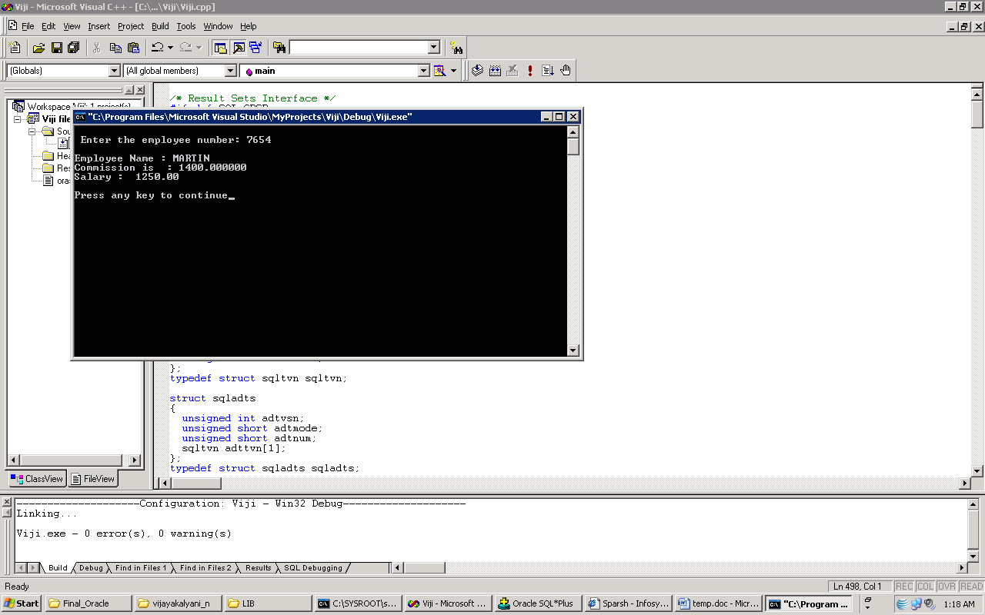
Example using Pro*C++ Cntd…

Slide 65
Summary
The Pro*C/C++ precompiler enables developer to create an applications that can access Oracle database
SQL statements within a programming language called Embedded SQL statements.
SQLCA is the SQL communication area between Oracle and your Pro *C/C++ program
Host variables allow communication between Oracle and your program.
A collection of related items ,declared as a host variable is called a host array.
A cursor identifies the current row in the set of rows returned by the query.
The Pro*C/C++ Precompiler treats a PL/SQL block like a single embedded SQL statement.

Slide 66
Thank You

